Slide 1
Python Programming
PYTHON ERRORS AND BUILT-IN EXCEPTIONS

Slide 2
Exception
Exception can be said to be any abnormal condition in a program resulting to the disruption in the flow of the program.
Two important features
1. Exception handling-
Error that happens during execution of program, non programmers view. Exception is an object
2. Assertions
Used to handle unexpected error in python program.
Python (interpreter) raises exceptions when it encounter errors. For example: divided by zero.

Slide 3
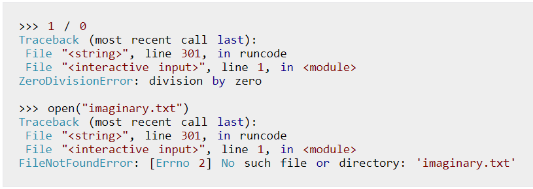
Examples

Slide 4
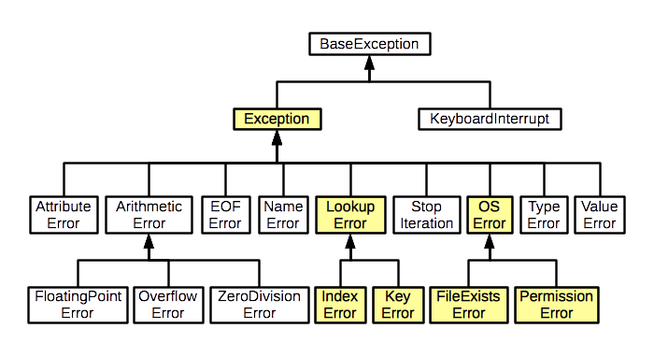
Exception Hierarchy

Slide 5
Python Built-in Exceptions
Exception | Cause of Error
AssertionError | Raised when assert statement fails.
AttributeError | Raised when attribute assignment or reference fails.
EOFError | Raised when the input() functions hits end-of-file condition.
FloatingPointError | Raised when a floating point operation fails.
GeneratorExit | Raise when a generator's close() method is called.
ImportError | Raised when the imported module is not found.
IndexError | Raised when index of a sequence is out of range.
KeyError | Raised when a key is not found in a dictionary.
KeyboardInterrupt | Raised when the user hits interrupt key (Ctrl+c or delete).
MemoryError | Raised when an operation runs out of memory.
NameError | Raised when a variable is not found in local or global scope.

Slide 6
Python Built-in Exceptions
Exception | Cause of Error
OSError | Raised when system operation causes system related error.
OverflowError | Raised when result of an arithmetic operation is too large to be represented.
ReferenceError | Raised when a weak reference proxy is used to access a garbage collected referent.
RuntimeError | Raised when an error does not fall under any other category.
StopIteration | Raised by next() function to indicate that there is no further item to be returned by iterator.
SyntaxError | Raised by parser when syntax error is encountered.
IndentationError | Raised when there is incorrect indentation.
TabError | Raised when indentation consists of inconsistent tabs and spaces.
SystemError | Raised when interpreter detects internal error.
SystemExit | Raised by sys.exit() function.
NotImplementedError | Raised by abstract methods.

Slide 7
Python Built-in Exceptions
Exception | Cause of Error
TypeError | Raised when a function or operation is applied to an object of incorrect type.
UnboundLocalError | Raised when a reference is made to a local variable in a function or method, but no value has been bound to that variable.
UnicodeError | Raised when a Unicode-related encoding or decoding error occurs.
UnicodeEncodeError | Raised when a Unicode-related error occurs during encoding.
UnicodeDecodeError | Raised when a Unicode-related error occurs during decoding.
UnicodeTranslateError | Raised when a Unicode-related error occurs during translating.
ValueError | Raised when a function gets argument of correct type but improper value.
ZeroDivisionError | Raised when second operand of division or modulo operation is zero.

Slide 8
Catching Exceptions in Python
Exception is an event, which occurs during the execution of program and disrupts the normal flow of program's instructions.
When a Python script raises an exception, it must either handle the exception immediately otherwise it terminates and quits.
If you have some suspicious code that may raise an exception, you can defend your program by placing the suspicious code in a try: block.
After the try: block, include an except: statement, followed by a block of code which handles the problem as elegantly as possible.
Different ways of Exception Handling in Python are:
– try....except...else
– try...except
– try...finally

Slide 9

try...except..
Catches all exceptions that occur
It is not considered as good programming practice though it catches all exceptions as it does help the programmer in identifying the root cause of the problem that may occur.
Syntax:
try:
You do your operations here;
......................
except ExceptionA:
If there is ExceptionA, then execute this block.
except ExceptionB:
If there is ExceptionB, then execute this block.
......................
Sample Example

Slide 10
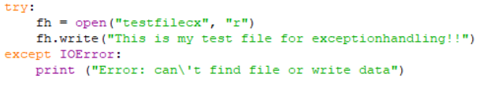

Example
Code:
Output:

Slide 11
try...except...else
A single try statement can have multiple except statements
– Useful when we have a try block that may throw different types of exceptions
– Code in else-block executes if the code in the try: block does not raise an exception
Syntax:
try:
You do your operations here;
......................
except ExceptionA:
If there is ExceptionA, then execute this block.
except ExceptionB:
If there is ExceptionB, then execute this block.
......................
else:
If there is no exception then execute this block
Sample Example

Slide 12
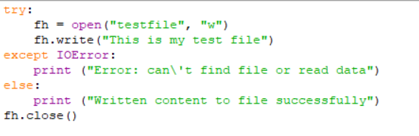

Example
Code:
Output:

Slide 13
try...finally
Finally block is a place to put any code that must execute irrespective of try-block raised an exception or not.
Else block can be used with finally block
Syntax:
try:
You do your operations here;
......................
Due to any exception, this may be skipped.
finally:
This would always be executed.
Sample Example

Slide 14
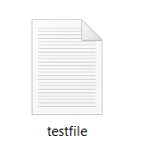
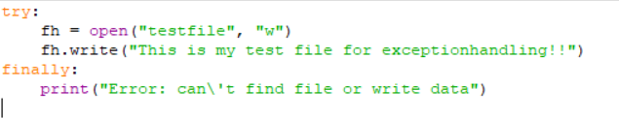

Example
Code
Output

Slide 15
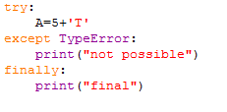
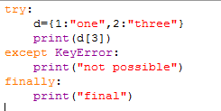
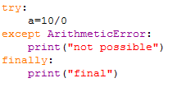
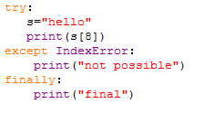
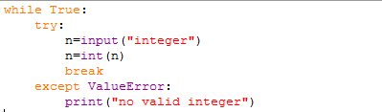
Sample Codes

Slide 16
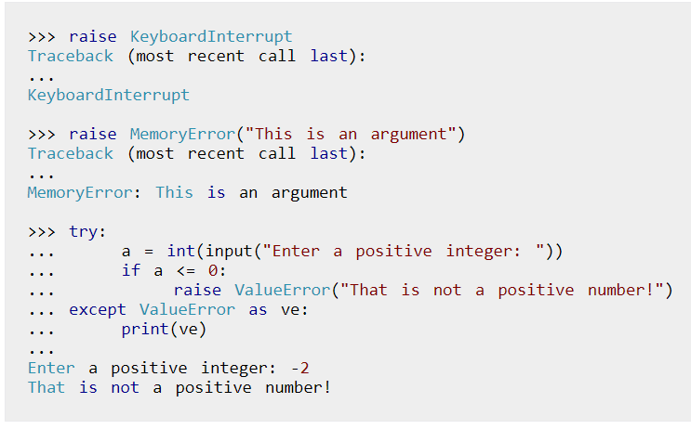
Raising Exceptions
In Python programming, exceptions are raised when corresponding errors occur at run time, but we can forcefully raise it using the keyword raise.
We can also optionally pass in value to the exception to clarify why that exception was raised.

Slide 17
Custom Exceptions
Python also allows you to create your own exceptions (user defined) by deriving classes from the standard built-in exceptions.
Exceptions should typically be derived from the Exception class, either directly or indirectly.
Example:
class myerror(Exception): # class myerror is inherited from Base Cass Exception
def fn(self): #function header
print("error")
try:
raise myerror # forcing to raise an exception
except myerror as me: # exception is cached
me.fn() # function get executed
error

Slide 18
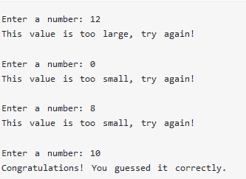
Custom Exceptions cont….
class Error(Exception): # Base class for other exceptions
Pass
class ValueTooSmallError(Error): #Raised when the input value is too small
pass
class ValueTooLargeError(Error): #Raised when the input value is too large
pass
number = 10
while True:
try:
i_num = int(input("Enter a number: "))
if i_num < number:
raise ValueTooSmallError
elif i_num > number:
raise ValueTooLargeError
break
except ValueTooSmallError:
print("This value is too small, try again!")
print()
except ValueTooLargeError:
print("This value is too large, try again!")
print()
print("Congratulations! You guessed it correctly.")

Slide 19

Here, we have defined a base class called Error.
The other two exceptions (ValueTooSmallError and ValueTooLargeError) that are actually raised by our program are derived from this class.
This is the standard way to define user-defined exceptions in Python programming, but you are not limited to this way only.
Code:
class Invalid(Exception):
def check(self,age):
self.age=age
if age<18:
print("sorry")
try:
raise Invalid()
except Invalid as e:
e.check(12)

Slide 20
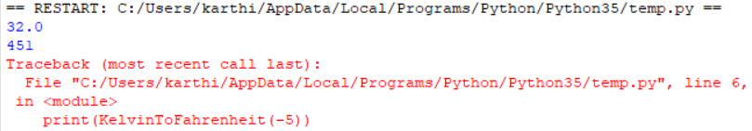
Assertion
Way of telling a program to test a condition and trigger an error if condition is false
Syntax:Assert<condition>,<optional message>
Code:
def KelvinToFahrenheit(Temperature):
assert (Temperature >= 0),"Colder than absolute zero!"
return ((Temperature-273)*1.8)+32
print(KelvinToFahrenheit(273))
print(int(KelvinToFahrenheit(505.78)))
print(KelvinToFahrenheit(-5))

Slide 21
Check out these examples
Write a Program to create custom Exception for InvalidLogin.

Slide 22
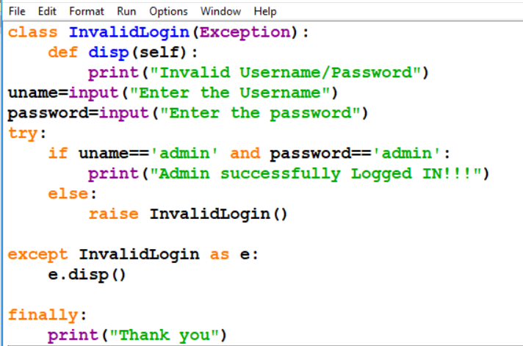
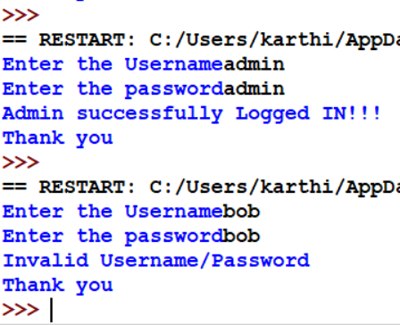
Sample Code

Slide 23
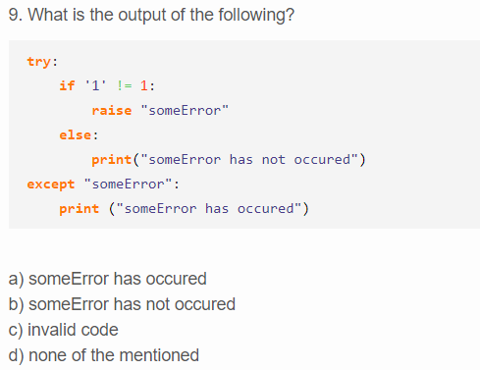
Quiz

Slide 24
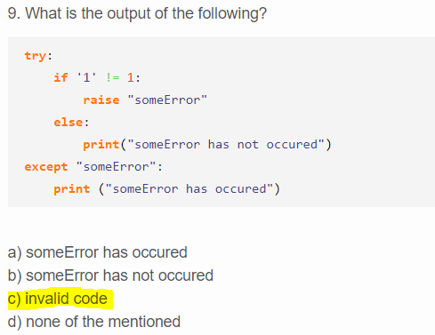
Answer

Slide 25
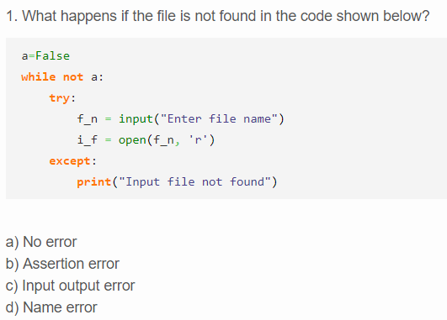
Quiz

Slide 26
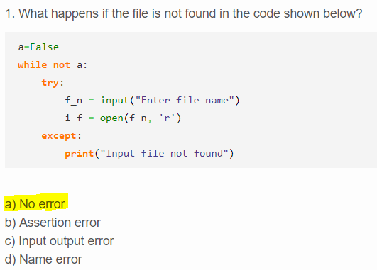
Answer

Slide 27
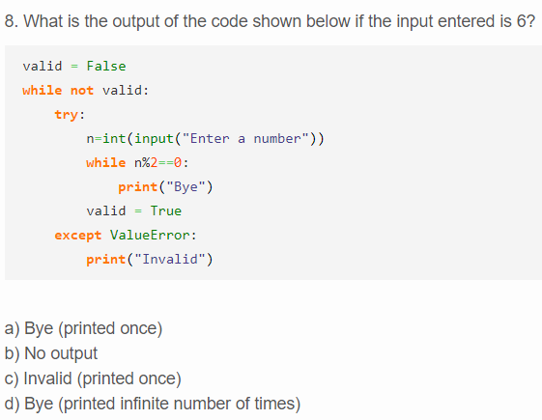
Quiz

Slide 28
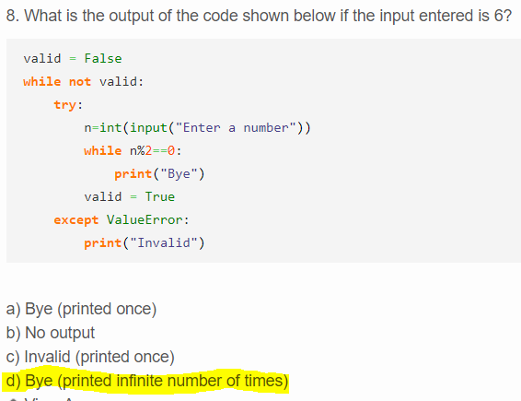
Answer

